Slide 1
Requirements Elicitation and Documantation
CS330 S06

Slide 2
Requirements Stakeholders
Involves technical staff working with customers to find out about the application domain, the services that the system should provide and the system’s operational constraints.
Involves working with customer (who pays), end-users, managers, engineers involved in maintenance, domain experts, trade unions, etc. Collectively these are called the stakeholders.

Slide 3
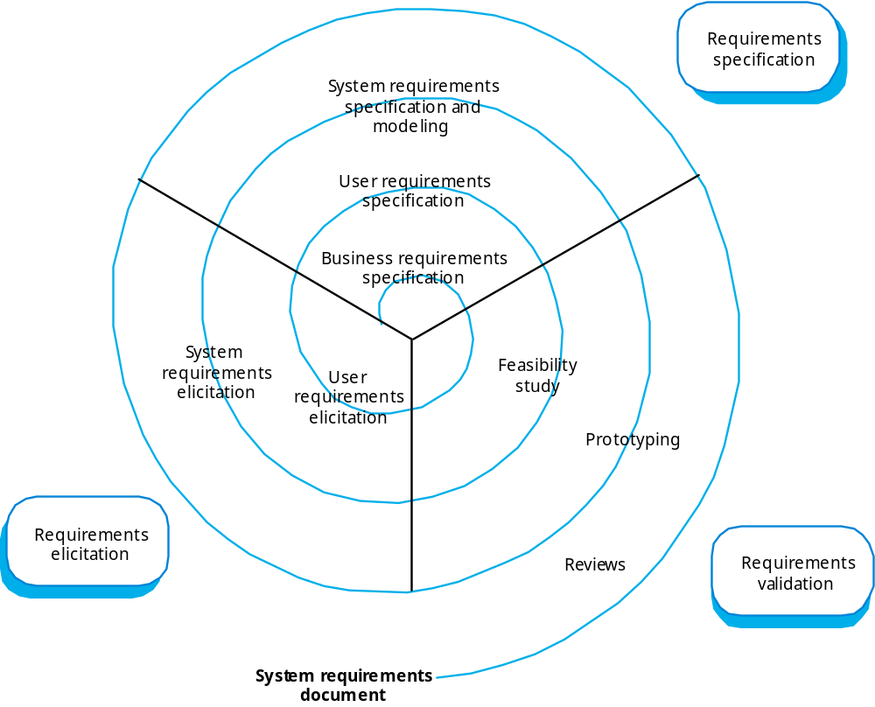
Requirements engineering

Slide 4
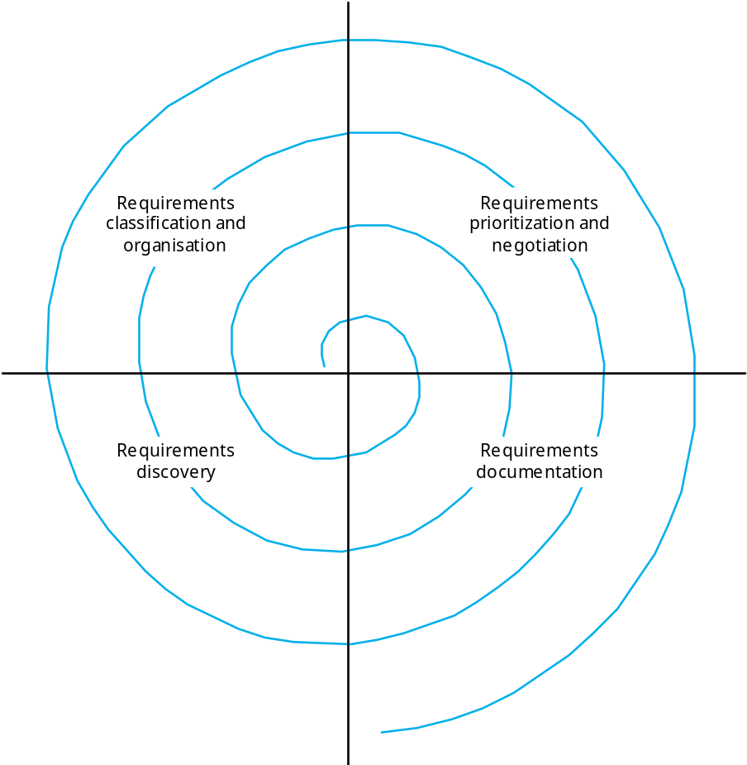
A better requirements spiral

Slide 5
Requirements Process activities
Develop requirements plan and timeline (define spiral)
Requirements discovery
  Interacting with stakeholders to discover their requirements. Domain requirements are also discovered at this stage.
Requirements classification and organisation
  Groups related requirements and organises them into coherent clusters.
Prioritisation and negotiation
  Prioritising requirements and resolving requirements conflicts.
Requirements documentation
  Requirements are documented and input into the next round of the spiral.

Slide 6
Problems of requirements analysis
Stakeholders don’t know what they really want.
Stakeholders express requirements in their own terms.
Different stakeholders may have conflicting requirements.
Organisational and political factors may influence the system requirements.
The requirements change during the analysis process. New stakeholders may emerge and the business environment change.

Slide 7
Requirements discovery
The process of gathering information about the proposed and existing systems and distilling the user and system requirements from this information.
Sources of information include documentation, system stakeholders and the specifications of similar systems.

Slide 8
Use Business Concerns to Drive Requirements Elicitation
If a system is to be useful, it must contribute to the key concerns of the business. If the concerns are identified and used as drivers of the requirements elicitation process, there will be higher confidence that the system will meet real organization needs.
Making the business concerns explicit helps to focus and clarify these goals.

Slide 9
Requirements Elicitation Caveat
Don’t piecemeal the customer to death.
Have an elicitation plan and follow it.
Analyze what you have and then plan to fill in the gaps.
Your customer’s time is precious.
DO NOT tell them—”give us your requirements by Friday so we can write our document.”

Slide 10
To whom do we talk?
Stakeholder (anyone materially affected by system)
  Customer (economic buyer)
  User
  Impacted System Administrators
Actors (someone or something outside the system that interacts with the system) including users and developers of interacting systems.
Regulators
Driven by kind of system (shrink wrap, vertical, custom)

Slide 11
Collect Requirements from Multiple Viewpoints
If requirements are collected from a single viewpoint, they are unlikely to meet other stakeholders’ requirements.
Collecting requirements from multiple viewpoints is a useful way to prioritize requirements
Identified viewpoints can be used to help
  organize requirements elicitation and
  organize the requirements specification, too.

Slide 12
Types of viewpoint
Interactor viewpoints
  People or other systems that interact directly with the system. In an ATM, the customer’s and the account database are interactor VPs.
Indirect viewpoints
  Stakeholders who do not use the system themselves but who influence the requirements. In an ATM, management and security staff are indirect viewpoints.
Domain viewpoints
  Domain characteristics and constraints that influence the requirements. In an ATM, an example would be standards for inter-bank communications.

Slide 13
Viewpoint identification
Identify viewpoints using
  Providers and receivers of system services;
  Systems that interact directly with the system being specified;
  Regulations and standards;
  Sources of business and non-functional requirements.
  Engineers who have to develop and maintain the system;
  Marketing and other business viewpoints.

Slide 14
Discussion Summary
A requirements analyst can use a discussion summary to summarize information gathered during elicitation and validate it through a review.
Notes gathered during the elicitation should fit into the discussion summary template
The discussion summary outline can serve as a guide for a novice requirements analyst in leading interviews and meetings
  Discussion Summary outline
  Project background
    Purpose of project
    Scope of project
    Other background information
  Perspectives
    Who will use the system?
    Who can provide input about the system?
  Project Objectives
    Known business rules
    System information and/or diagrams
    Assumptions and dependencies
    Design and implementation constraints
  Risks
  Known future enhancements
  References
  Open, unresolved or TBD issues

Slide 15
Requirements Elicitation Techniques
Interviewing and questionnaires
Requirements workshops
Braining Storming and idea reduction
Storyboards
Use Cases
Role Playing
Prototyping

Slide 16
Requirements Elicitation
Supporting techniques Techniques
  Domain Analysis
  Review Internal / External Documents
  Review Existing Software
  Business Plans
  Observation
  Ethnography / Temporary Assignment
Notes:
Pros/Cons of Each Technique
INTERVIEW
+ Qualitative & Quantitative info - Requires skill
+ Detail and summary info - Results may contain bias
+ Good for surfacing requirements - Produce misleading or inaccurate info
QUESTIONNAIRE
+ Anonymous -> more honest Responses - Imperfect Recall
+ Can survey many people easily - No answer = no information
+ Best for limited responses, close-ended ?s - Misunderstood questions
+ Gets many users involved - Low reliability or validity
GROUP MEETING
+ Decisions can be made - More people = more time for decision
+ Both detail & summary info - Wastes time, interruptions
+ Good for surfacing requirements - Arguments about turf/politics
+ Gets many users involved - Wrong participants, low results
OBSERVATION
+ Surface unarticulated procedures, criteria - Not representative time period
+ Not biased by opinion - Behavior change due to observation
+ Good problem domain understanding - Time consuming

Slide 17
Interviewing
In formal or informal interviewing, the RE team puts questions to stakeholders about the system that they use and the system to be developed.
There are two types of interview
  Closed interviews where a pre-defined set of questions are answered.
  Open interviews where there is no pre-defined agenda and a range of issues are explored with stakeholders.

Slide 18
Interviews in practice
Interviews are good for getting an overall understanding of what stakeholders do and how they might interact with the system.
Interviews are not good for understanding domain requirements
  Requirements engineers cannot understand specific domain terminology;
  Some domain knowledge is so familiar that people find it hard to articulate or think that it isn’t worth articulating.

Slide 19
The “Yes, But” Syndrome
First time users see the system the first reaction is either, “wow this is so cool” or “Yes, but, hmmmmm, now that I see it, what about this…? Wouldn’t it be nice …?
Users reaction is simply human nature
Anticipate that there will be “yes, buts” and add time and resources to plan for feedback.
Need to employ techniques that get the “yes, buts” out early.
Tends to be User Interface centric, these tend to be the touch points of the system by the users.

Slide 20
The “Living with the Sins of your Predecessors” syndrome
Like it or not your users (marketing) and developers remember what happened in the past.
  Quality programs that promised things would be different.
  The last project where requirements were vague and/or were delivered short of expectations.
The team “unilaterally” cut important features out of the last release.
Need to build trust, slowly. Do not over commit to features, schedule, or budget.
Build success by delivering highest priority features early in the process.
Notes:
Dilbert – “Work is very rewarding”

Slide 21
The “Undiscovered Ruins” Syndrome
Teams struggle with determining when they are done with requirements elicitation.
  Why is it like asking “how many undiscovered ruins are there?”
  Real question should be are we done when all the requirements are elicited or when they have they found at least enough?
First scope the requirements elicitation effort by defining the problem or problems that are to be solved with the system.
Employ techniques that help find some of those ruins and have the stakeholders buy-into the requirements.

Slide 22
The “User and the Developer” Syndrome
Characteristic
Response
Users do not know what they want, or they know what they want but cannot articulate it.
Users think they know what they want until developers give them what they said they wanted.
Analysts think they understand user problems better than users do.
Everybody believes everybody else is politically motivated.
Recognize and appreciate the user as domain experts; try different techniques.
Provide alternative elicitation techniques earlier; storyboard, role playing, prototypes, and so on.
Put the analyst in the users place. Try role playing for an hour or a day.
Yes, its part of human nature, so lets get on with the program.

Slide 23
Technique: Interviewing
Simple direct technique
Context-free questions can help achieve bias-free interviews
Then, it may be appropriate to search for undiscovered requirements by exploring solutions.
Convergence on some common needs will initiate a “requirements repository” for use during the project.
A questionnaire is no substitute for an interview, but can help between first and other interviews to refine questions for next interview.
Notes:
Examples of context-free questions?

Slide 24
Interview: Context free question
Goal is to prevent prejudicing the user’s response to the questions.
Examples:
  Who is the user?
  Who is the customer?
  Are their needs different?
  Where else can a solution to this problem be found?
Context-free questions also parallel the questions salespeople are taught to ask as part of a technique called “solutions selling.”
After context-free questions are asked, suggested solutions can be explored.

Slide 25
Effective interviewers
Interviewers should be open-minded, willing to listen to stakeholders and should not have pre-conceived ideas about the requirements.
Prompt the interviewee with a question or a proposal and should not simply expect them to respond to a question such as ‘what do you want’.
Do it as a team, with prescribed Roles.
  Questioner
  Follow Question Generator
  Note Taker (possibly Record if okay with customer)
Recommend Changing Roles during interview.

Slide 26
Interview: Show time
Establish Customer or User Profile
Assessing the Problem
Understanding the User Environment
Recap the Understanding
Analyst’s Inputs on Customer’s Problems
Assessing Your Solution (if applicable)
Notes:
These are on the course web site. Each section on slide has several questions under it in the document.
Establish Customer or User Profile
Name:
Company:
Industry:
Job Title:
What are your key responsibilities?
What outputs do you produce?
For Whom?
How is success measured?
Which problems interfere with your success?
What, if any, trends make your job easier or more difficult?
Assessing the Problem
For which problems do you lack good solutions?
What are they? (Hint: Keep asking, “Anything else?”)
For each problem ask:
Why does the problem exist?
How do you solve it know?
How would you like to solve it?
Understanding the User Environment
Who are the users?
What is their educational background?
What is their computer background?
Are users experienced with this type of application?
Which platforms are in use?
What are your plans for future platforms?
What are your expectations for usability for this type of product?
What are your expectations for training time?
What kinds of user help do you need?
Recap the Understanding
You have told me:
(List customer described problems in your own words.)
Analyst’s Inputs on Customer’s Problems
(Validate or Invalidate assumptions)
For each problem ask,
Is this a real problem?
What are the reasons for the problem?
How do you currently solve the problem?
How would you like to solve the problem?
How would you rank solving these problems in comparison to others you’ve mentioned?
Assessing Your Solution (if applicable)
What if you could
How would you rank the importance of these?

Slide 27
Scenarios
Scenarios are real-life examples of how a system can be used.
They should include
  A description of the starting situation;
  A description of the normal flow of events;
  A description of what can go wrong;
  Information about other concurrent activities;
  A description of the state when the scenario finishes.

Slide 28
Technique: Use Cases
Use Cases identify the who, what, and how of system behavior.
Use Cases describe the interactions between a user and a system, focusing on what they system “does” for the user.
The Use Case model describes the totality of the systems functional behavior.
Early stages: After you have an overview of the use cases, perhaps only by a phrase apiece, expand 10% of them in detail.
More later …
Notes:
Weakness of Use Cases -- we miss the “ilities”, the quality attributes.
Those must be addressed explicitly eventually.

Slide 29
Use Cases
A use case is a description of a specific interaction that a user may have with the system.
Use cases are deceptively simple tools for describing the functionality of the software.
  Use cases do not describe any internal workings of the software, nor do they explain how that software will be implemented.
  They simply show how the steps that the user follows to use the software to do his work.
  All of the ways that the users interact with the software can be described in this manner.

Slide 30
Technique: Role Playing – variant on use cases
Role playing allows stakeholders to experience the user’s world from the user’s perspective.
A scripted walkthrough may replace role playing in some situations, with the script becoming a live storyboard.
(Class-Responsibility-Collaboration (CRC) cards, often used in object-oriented analysis, are a derivative of role playing.)

Slide 31
Technique: Storyboarding
The purpose of storyboarding is to elicit early “Yes, But” reactions.
Storyboards can be positive, active, or inactive.
Storyboards identify the players, explain what happens to them, and describes how it happens.
Make the storyboard sketchy, easy to modify, and unshippable.
Storyboard early and often on every project with new or innovative content.

Slide 32
Technique: Prototyping
Prototyping is especially effective in addressing the “Yes, But” and the “Undiscovered Ruins” syndromes.
A software requirements prototype is a partial implementation of a software system, built to help developers, users, and customers better understand system requirements.
Prototype the “fuzzy” requirements: those that, although known or implied, are poorly defined and poorly understood.

Slide 33
Reuse Requirements
Saves money and time. Studies have shown that similar systems can re-use up to 80% of the requirements.
Reuse reduces risk. Reused requirements have a better chance of being understood by all the stakeholders.
Requirements reuse may lead to additional reuse in other lifecycle activities.
  Component design
  Tests
  Code
Need “Reuse” cases just like use-cases. Not just what is reused, but the processes as well.

Slide 34
Technique: Requirements Workshop
The requirements workshop is perhaps the most powerful technique for eliciting requirements on larger projects.
It gathers all key stakeholders together for a short but intensely focused period.
The use of an outside facilitator experienced in requirements management can ensure the success of the workshop.
Brainstorming is the most important part of the workshop for “new” or COTS products

Slide 35
Preparing for the workshop
Selling the workshop concept to stakeholders
Ensuring the Participation of the Right Stakeholders
Logistics
  Try and prevent Murphy’s law
  Includes travel, lighting, and even “afternoon sugar filled snacks.”
Warm-up materials
  Project-specific information
  Out-of-box thinking preparation

Slide 36
Role of the Facilitator
Establish professional and objective tone to the meeting.
Start and stop the meeting on time.
Establish and enforce the “rules” for the meeting.
Introduce the goals and agenda for the meeting.
Manage the meeting and keep the team “on track.”
Facilitate a process of decision and consensus making, but avoid participating in the content.
Make certain that all stakeholders participate and have their input heard.
Control disruptive or unproductive behavior.

Slide 37
Workshop Agenda
Set an agenda before the workshop and publish it along with the other pre-workshop documentation.
Balance is the key, try to stay on the agenda, but do not strictly obey it, especially if good discussion is going on.
Order lunch in, and have a light working lunch. :-)

Slide 38
Running the Workshop
Allow for human behavior, and have fun with it.
  Do not “attack” other members.
  Do not get on a soap box.
  Do not come back late from a break.
Workshop tickets
  Give every stakeholder 3 workshop tickets
    1 for being late
    1 for “cheap shot”
    1 for “soap box”
  Facilitator takes tickets when appropriate. If you do not have a ticket create a fund to add to, like $1 to pot for after workshop activities.

Slide 39
Workshop Problems and Suggestions
Time Management
  It’s difficult to get going after breaks and lunch.
  Key shareholders may be late returning
Grandstanding, domineering positions
Lack of input from stakeholders
Negative comments, petty behaviors, and turf wars
Flagging energy after lunch
Facilitator keeps a timer for all breaks and fines anyone that is late, everyone gets one free pass.
Everyone gets one 5 minute position statement.
Facilitator encourages everyone to use 5-minute position and great idea ticket.
Use “Cheap Shot Tickets”, all others cost money.
Lite lunches, afternoon breaks, rearrange seating
Notes:
What does this have to do with engineering? Everything. So far, the only creatures we have found to use as engineers are people. Same goes for marketing, testing, strategic planning, etc.
The engineer’s tendency to shy away from actions needed to encourage, cajole, and motivate humans to be productive leads to unproductive meetings.

Slide 40
Technique: Brainstorming
Brainstorming involves both idea generation and idea reduction.
The most creative, innovative ideas often result from combining, seemingly unrelated ideas.
Various voting techniques may be used to prioritize the ideas created.
Although live brainstorming is preferred, web-based brainstorming may be a viable alternative in some situations

Slide 41
Rules for Brainstorming
Do not allow criticism or debate.
Let your imagination soar
Generate as many ideas as possible
Mutate and combine ideas
Idea Reduction
  Pruning ideas that are not worthy of further discussion
  Grouping of similar ideas into one super topic
Prioritize the remaining ideas
Capture ideas, don’t just use a standard “board” because you are tempted to erase
Notes:
Banning criticism and banning debate is not just an attempt to “be nice”. It is necessary to not squelch creative thinking.

Slide 42
Requirements Review?
  Are the requirements complete?
  Are the requirements concise?
  Are the requirements correct?
  Are the requirements consistent?
  Are the requirements modular? Can they accommodate change?
  Are the requirements realistic?
  Is the requirement needed by the customer?
  Are the requirements traceable?
Notes:
Complete - do we have everything? (Don’t use phrases like “such as” or “for example”)
Concise - lack of ambiguity
Correct - is everything right?
Consistent - Do all the pieces match up? Are all conflicts resolved?
Modular -
Traceability - Can the representation be tied back directly to explicitly stated requirements?
Accommodation for change - As things inevitably change and grow, can be make changes to the model/representation without having to start over?

Slide 43
Requirements Specification
  Goal
    To provide a representation of the software for the customer’s review and approval
    Basis for Design and Acceptance Test
  Developed as a joint effort between the developer and the customer
  Serve as basis for review for both customer and developer
  Culmination of requirements analysis
  Tries to focus on What not How
Notes:
Definition: a description of what is desired rather than how it is to be realized/implemented
ONE OF THE MOST COMMON PROBLEMS IS OVER_CONSTRAINING THE DESIGN, THAT IS PUTTING A BUNCH OF DESIGN DECISIONS INTO THE REQUIREMENTS DOCUMENT.
THE SYSTEM MAY NEED TO KEEP TRACK OF LARGE AMOUNTS OF EMPLOYEE DATA – IT DOESN’T “Have to” USE MYSQL DATABASE.

Slide 44
Software Requirements Specification (SRS)
Includes Requirements Definition & Specification
Principles: [Heninger 80]
  Should specify external system behavior
  Should specify implementation constraints
  Should by easy to change
  Should serve as reference tool for maintenance
  Should record forethought about system lifecycle
  Should characterize acceptable responses to undesired events

Slide 45
Some Samples:
As Written: Software will not be loaded from unknown sources onto the system without first having the software tested and approved.
Better: 3.2.5.2 Software shall be loaded onto the operational system only after it has been tested and approved.
Better: 3.2.5.2 Software shall be loaded onto the operational system only after it has been tested IAW MIL-SPEC 3425 and approved by the CCB.

Slide 46
Another Sample
3.4.6.3 The system shall prevent the processing of duplicate electronic files by checking a new SDATE record. An email message shall be sent.
3.4.6.3 The system shall:
  a. Prevent processing of duplicate electronic files by checking the date and time of submission.
  b. Send the following email message:
    Request updated submission of date and time, if necessary, or
    That the processing was successful when successful.

Slide 47
Another Example:
Editor Grid Requirement
3.2.5.6 Grid facilities To assist in the positioning of entities on a diagram,
the user may turn on a grid in either centimetres or inches, via an
option on the control panel. Initially, the grid is off. The grid may be
turned on and off at any time during an editing session and can be
toggled between inches and centimetres at any time. A grid option
will be provided on the reduce-to-fit view but the number of grid
lines shown will be reduced to avoid filling the smaller diagram
with grid lines.

Slide 48
Problems!
Difficult to read
Mixes three different requirements:
  Functional requirement (the need for a grid)
  Non-functional requirement (grid units)
  Non-functional UI requirement (grid switching)

Slide 49
One last sample
3.2.8.6 When doing calculations, the software shall produce correct results.
No, You think????? Delete on sight….

Slide 50
Feasibility studies
A feasibility study decides whether or not the proposed system is worthwhile.
A short focused study that checks
  If the system contributes to organisational objectives;
  If the system can be engineered using current technology and within budget;
  If the system can be integrated with other systems that are used.

Slide 51
Feasibility study implementation
Based on information assessment (what is required), information collection and report writing.
Questions for people in the organisation
  What if the system wasn’t implemented?
  What are current process problems?
  How will the proposed system help?
  What will be the integration problems?
  Is new technology needed? What skills?
  What facilities must be supported by the proposed system?

Slide 52
Requirements management planning
During the requirements engineering process, you have to plan:
  Requirements identification
    How requirements are individually identified;
  A change management process
    The process followed when analysing a requirements change;
  Traceability policies
    The amount of information about requirements relationships that is maintained;
  CASE tool support
    The tool support required to help manage requirements change;

Slide 53
CASE tool support
Requirements storage
  Requirements should be managed in a secure, managed data store.
  Backing up multiple versions, not just the current one!
Change management
  The process of change management is a workflow process whose stages can be defined and information flow between these stages partially automated.
Traceability management
  Automated retrieval of the links between requirements.

Slide 54
Traceability
Traceability is concerned with the relationships between requirements, their sources and the system design
Source traceability
  Links from requirements to stakeholders who proposed these requirements;
Requirements traceability
  Links between dependent requirements;
Design traceability
  Links from the requirements to the design;

Slide 55
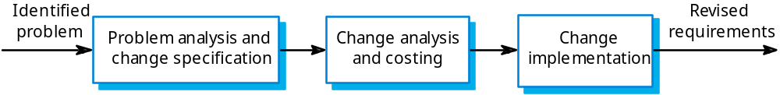
Requirements change management
Should apply to all proposed requirements changes.
Principal stages
  Problem analysis. Discuss requirements problem and propose change;
  Change analysis and costing. Assess effects of change on other requirements;
  Change implementation. Modify requirements document and other documents to reflect change.

Slide 56
Change Control
Change control is a method for implementing only those changes that are worth pursuing, and for preventing unnecessary or overly costly changes from derailing the project.
  Change control is an agreement between the project team and the managers that are responsible for decision-making on the project to evaluate the impact of a change before implementing it.
  Many changes that initially sound like good ideas will get thrown out once the true cost of the change is known.

Slide 57
Change Control
A change control board (CCB) is made up of the decision-makers, project manager, stakeholder or user representatives, and selected team members.
  The CCB analyzes the impact of all requested changes to the software and has the authority to approve or deny any change requests once development is underway.
  Before the project begins, the list of CCB members should be written down and agreed upon, Each CCB member should understand why the change control process is needed and what their role will be in it.
  Proposed change is documented and CCB considers costs/benefits.
  The CCB either accepts or rejects the change
  If the accepted the project manager updates the plan to reflect the new estimates. Otherwise, the change is documented as discussed and discarded and the team continues with the original plan.

Slide 58
Key points
The requirements engineering process includes a feasibility studies, requirements elicitation and analysis, requirements specification and requirements management.
Requirements elicitation and analysis is iterative involving domain understanding, requirements collection, classification, structuring, prioritisation and validation.
Systems have multiple stakeholders with different requirements.

Slide 59
Key points
Interviewing is a critical SE team skill!
Social and organisation factors influence system requirements.
Requirements validation is concerned with checks for validity, consistency, completeness, realism and verifiability.
Business changes inevitably lead to changing requirements.
Requirements management includes planning and change management.

Slide 60

Software Requirements Specification (SRS)
Let’s go over the sample template from the webpage.

Slide 61
Addational References
“Requirements Engineering A good practice guide,” Ian Sommerville and Pete Sawyer, John Wiley and Sons, 1997
“Managing Software Requirements; A Unified Approach,” Dean Leffingwell and Don Widrig, Addison-Wesley, 2000
Software Quality Measurement for Distributed Systems, RADC-TR-83-175
Requirements Engineering, Thayer, SMC 10/97, version 2
Richard Thayer, Software Requirements Engineering, IEEE, 1997
STEP, Operational Requirements for Automated Capabilities, STEP, 1991
MBASE, “Avoiding the Software Model-Clash Spiderweb,” IEEE Computer, November, 2000, pp. 120-122.

